Slide 1


REINFORCEMENT TEST
TABLEAU
KISHORE VASUDEVAN
22/04/2025
DATA ANALYTICS & DATA SCIENCE
FEB 25'

Slide 2


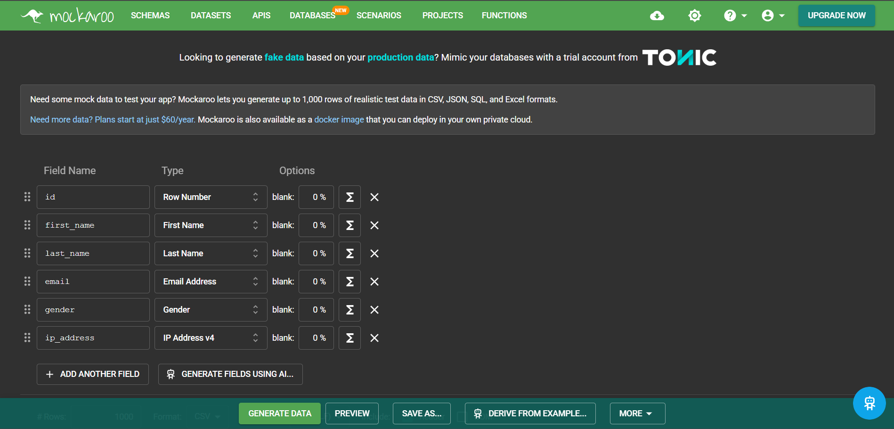
DATA PREPARATION

Slide 3

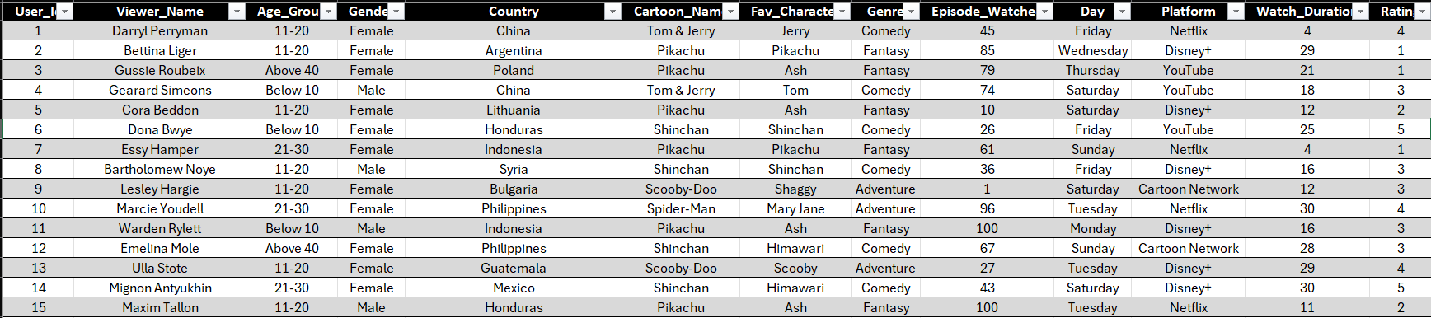
CARTOON DATASET

Slide 4
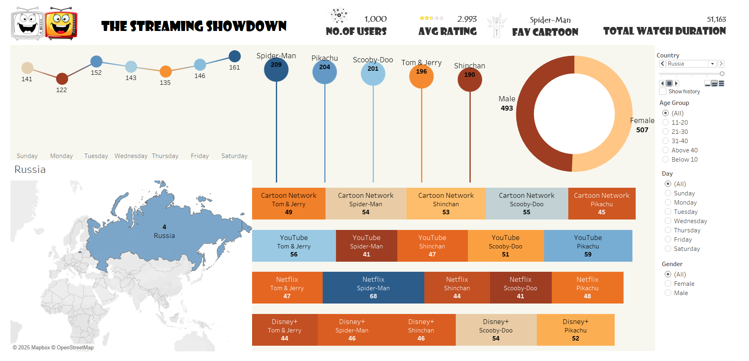
DASHBOARD

Slide 5
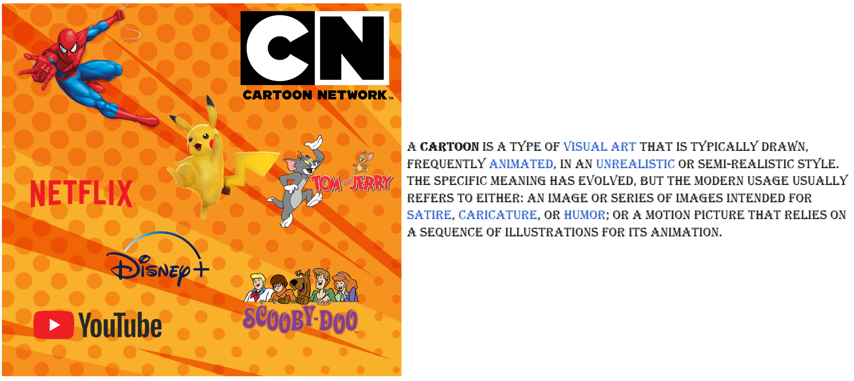
STORY TELLING
5

Slide 6
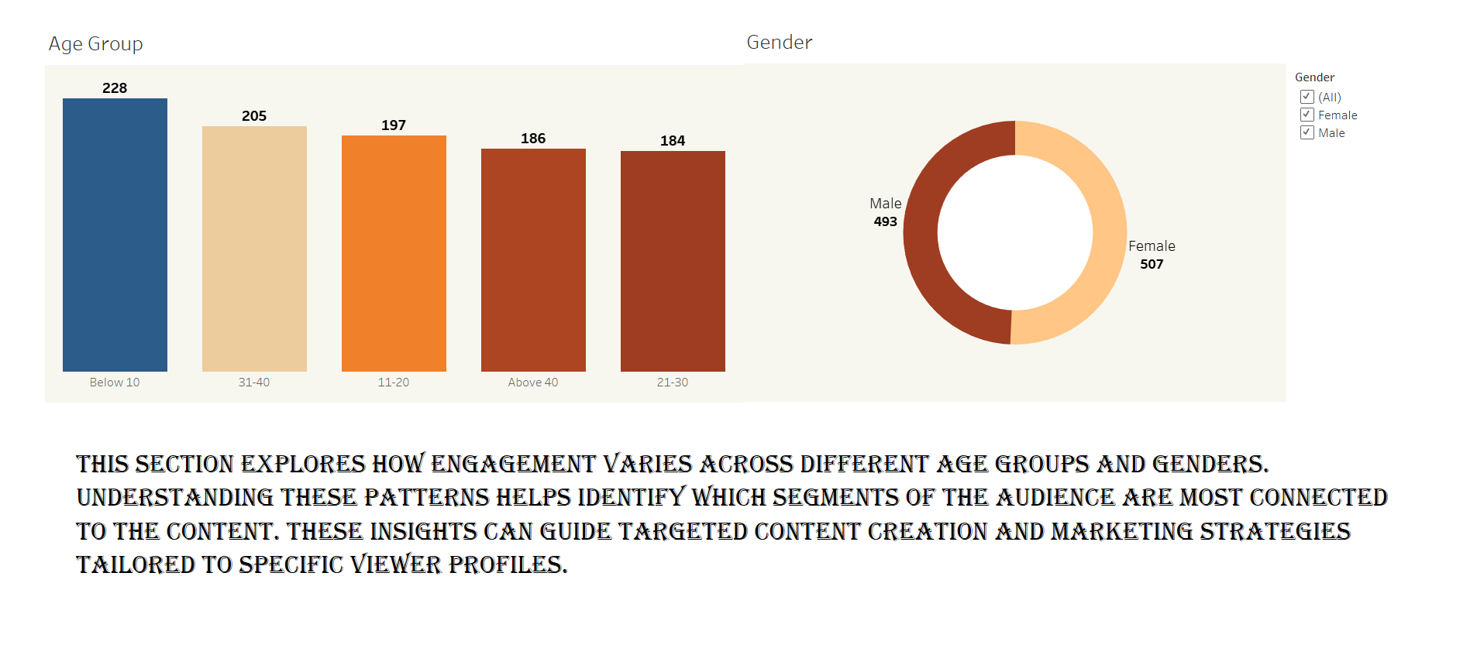
Audience Demographics
6

Slide 7
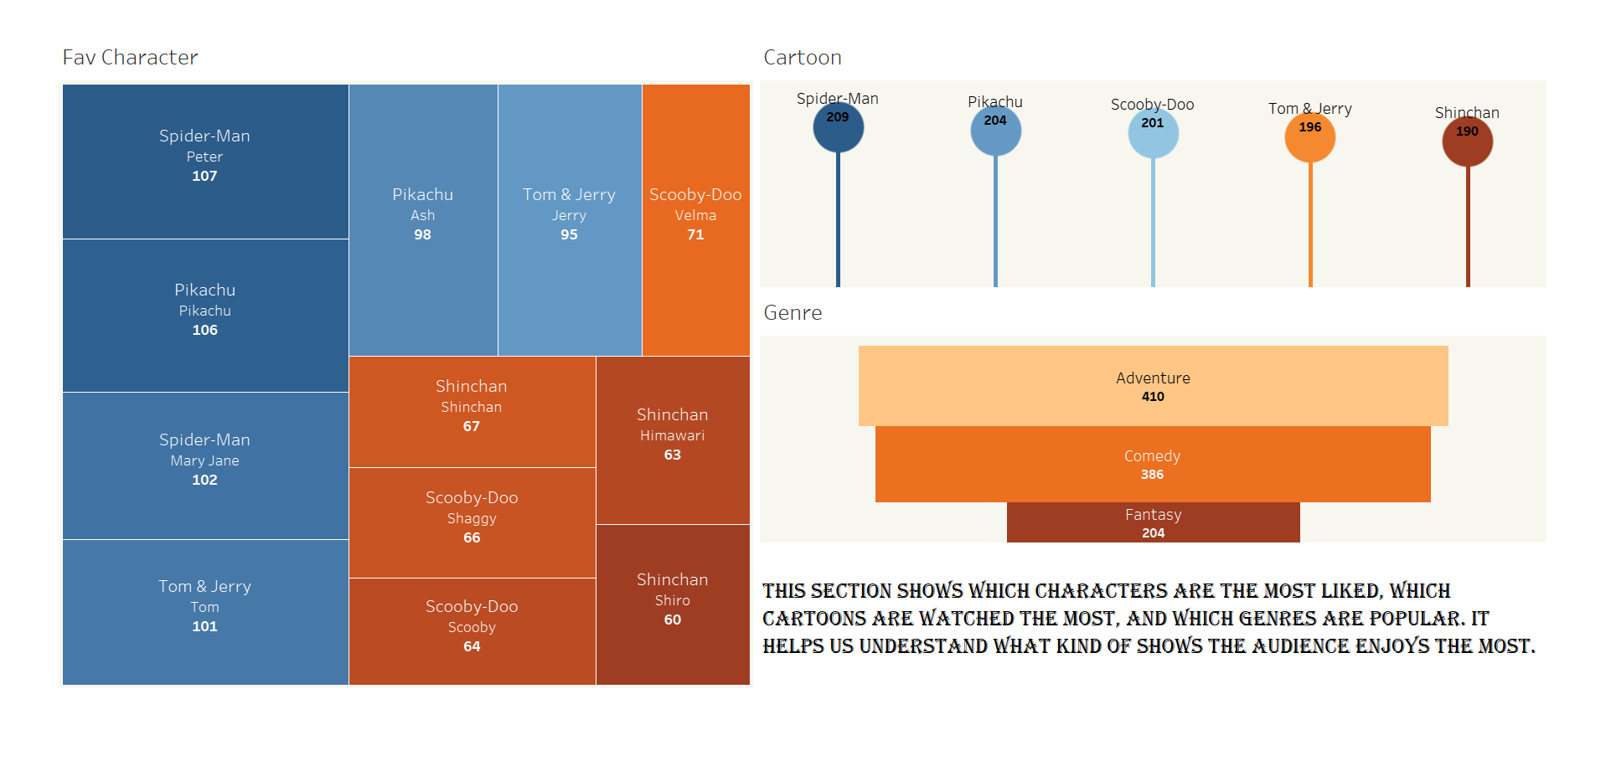
Preferences & Favorites
7

Slide 8
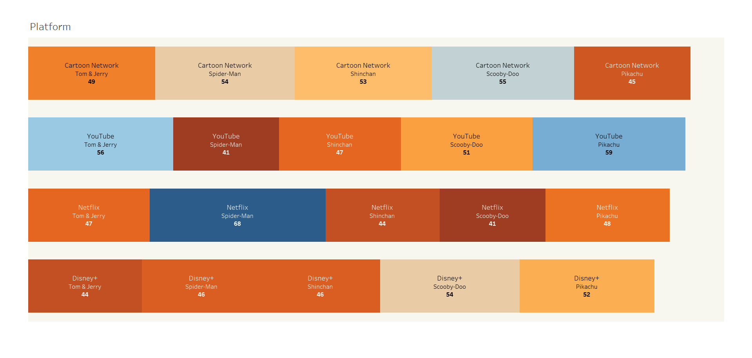
Platform Usage
8

Slide 9
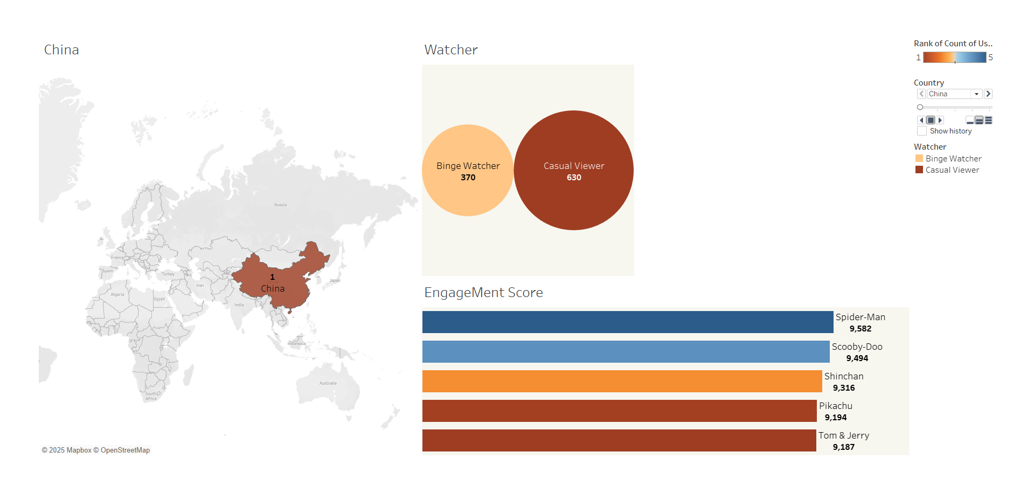
Engagement Spikes
9

Slide 10
INSIGHTS
Below 10 age group has a most viewer count 228 and followed by 31-40(205).
Most preferred cartoon was Spider-Man by viewer count 209.
Female gender is a highest viewer count of 507 but male has similar line
with 493 count.
Cartoon Network has highest view in platform in that particularly scooby-doo.
China holds the number one position in country wise.

Slide 11
FINDINGS
China holds the number one position with 187 users. The most watched cartoon is Scooby-Doo, with a total watch duration of 9,500 minutes.
Since Saturday is the binge-watching day, dropping new episodes then could boost our viewership.
Disney+ is at the bottom, so we could use the Saturday binge trend to give it a boost by releasing new content then.

Slide 12
CONCLUSION
Future growth lies in targeting young and female audiences, with China as a key market. Leveraging Saturday binge trends and releasing top content like Scooby-Doo and Spider-Man can boost engagement—especially on underperforming platforms like Disney+.

Slide 13
THANK YOU!!!

